Slide 1
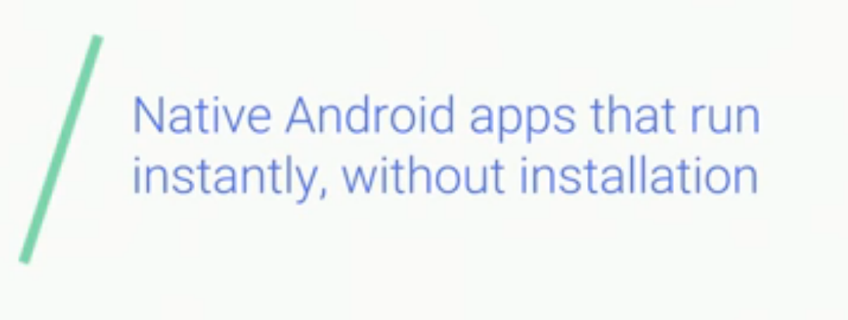

Slide 2
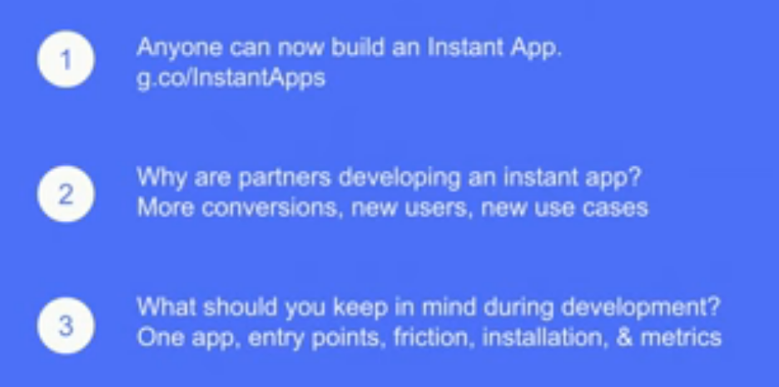

Slide 3
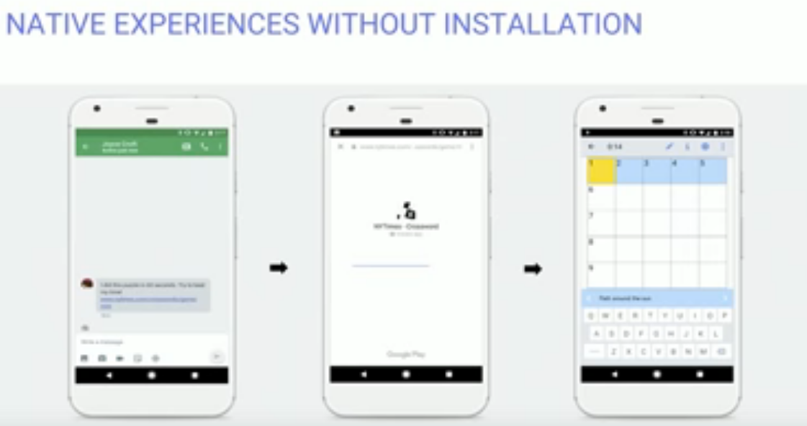

Slide 4
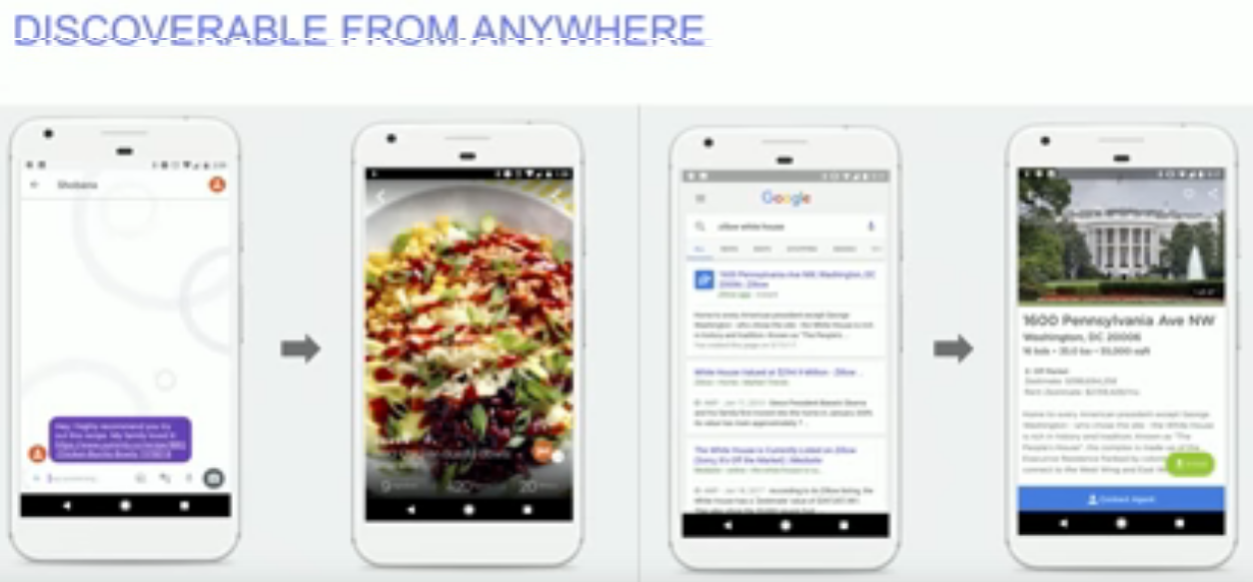

Slide 5
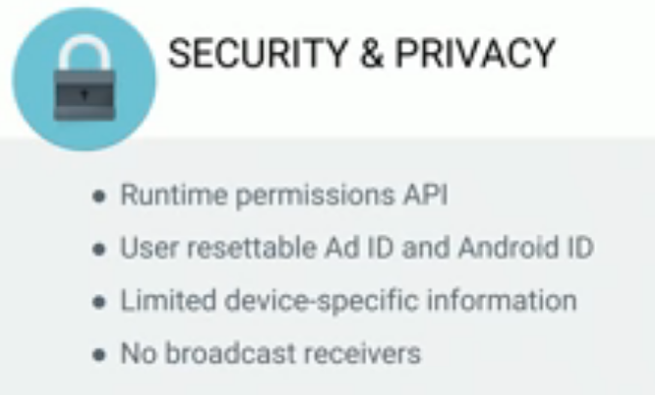

Slide 6
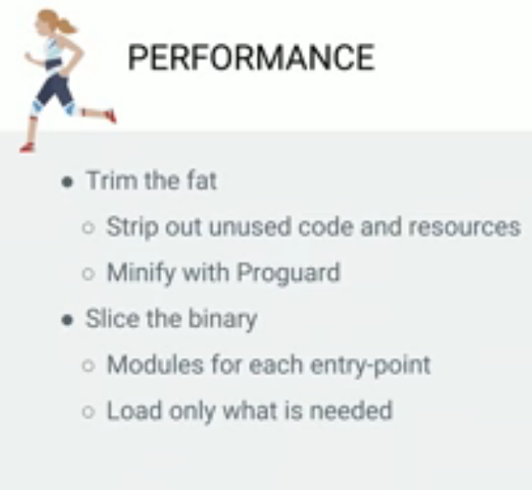

Slide 7
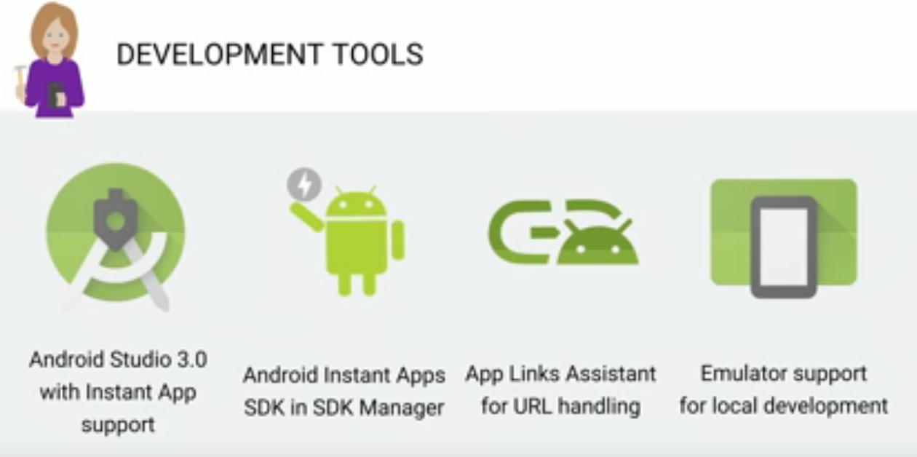

Slide 8
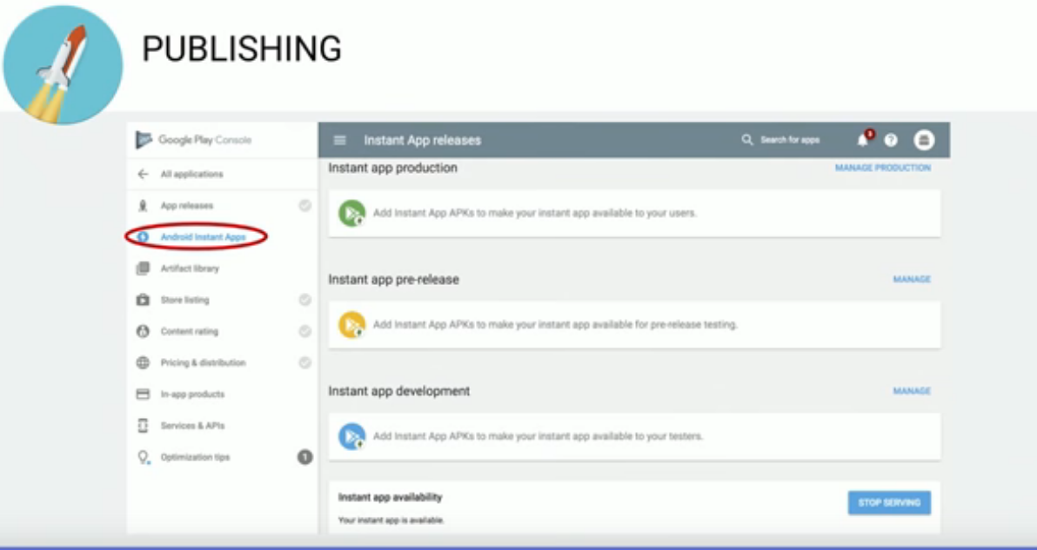

Slide 9
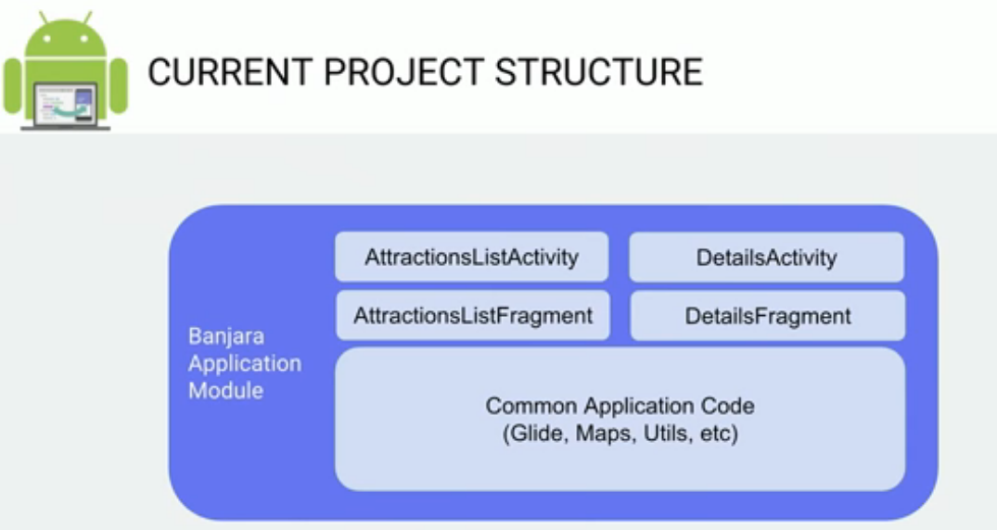

Slide 10
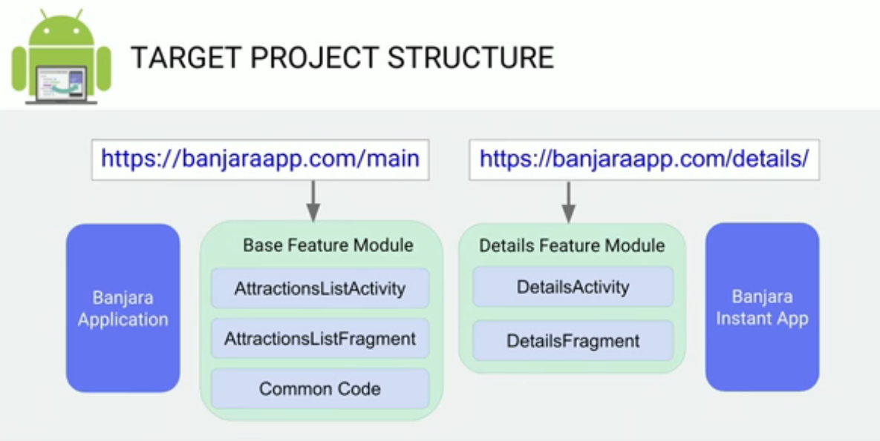

Slide 11
Back up till 23only now
https://stackoverflow.com/questions/44774512/minsdkversion-for-instantapp-support

Slide 12
Back up till 23only now
https://stackoverflow.com/questions/44774512/minsdkversion-for-instantapp-support

Slide 13
Important Links
https://developer.android.com/topic/instant-apps/getting-started/first-instant-app.html
https://codelabs.developers.google.com/codelabs/android-instant-apps/#4

Slide 14
